Slide 1
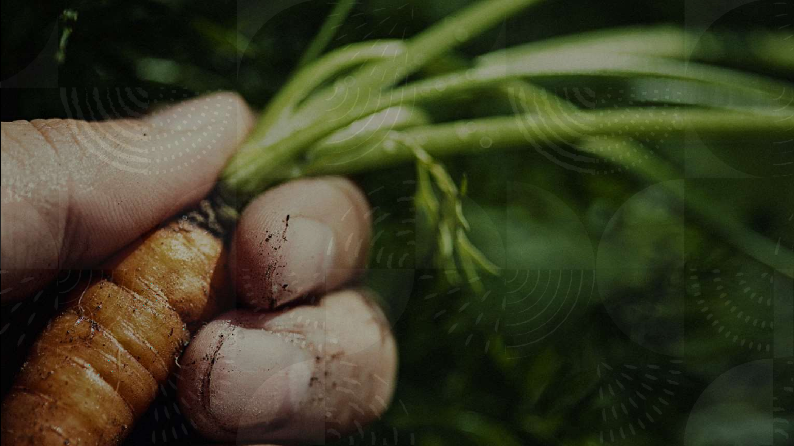
Disease Recognition in Potato Plants
Prepared By Group 8

Slide 2
Team Members
Akanksha R
CWID :20027573
Hari Kiran V G
CWID: 20021466

Slide 3


Overview
1. Problem Statement
2.Outline
3.Technical Architecture
3. Loading the Dataset
4.Dataset Description
5.Function to split Dataset
6.Data Augmentation
7.Building the Model
8. Model Architecture
9.Conclusion
10.References

Slide 4

Problem Statement
Farmers who grow potatoes are facing lot of economic losses every year because of various diseases that can happen to a potato plant. There are two common diseases known as early blight and late blight early blight is caused by a fungus and late blight is caused by a specific microorganism and if a farmer can detect these diseases early and apply appropriate treatment then it can save lot of waste and prevent the economic loss. The treatments for early blight and late blight are little different so it's important that you accurately identify what kind of disease is there in the potato plant.

Slide 5
Outline
Import Libraries
Load data and make labels
Data pre-processing
Model Building
Optimize
Fitting the model
Model Evaluation

Slide 6




Technical Architecture
Model Building – Tensor Flow, CNN , Data Augmentation ,tf dataset
Backend Server- tf serving Model Optimization Conclusion

Slide 7

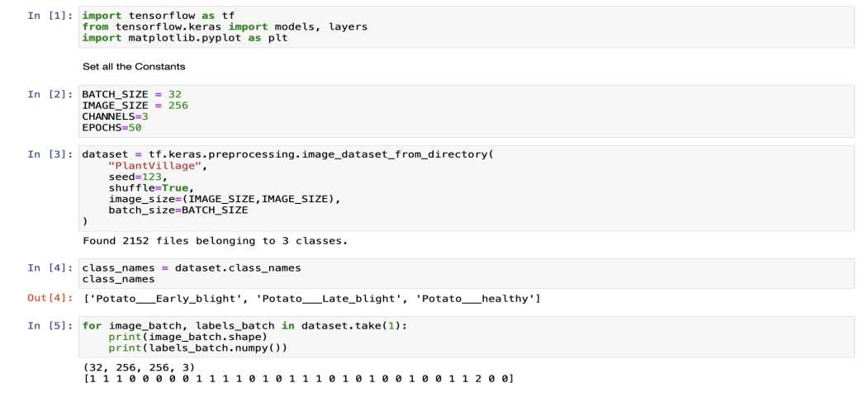
Loading the Dataset

Slide 8

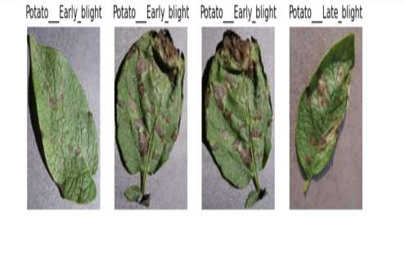
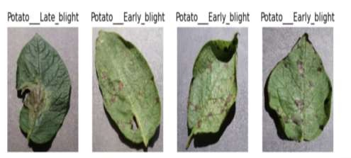
Dataset Description
Source: https://www.kaggle.com/datasets/arjuntejas wi/plant-village
There are two common diseases known as early blight and late blight early blight is caused by a fungus and late blight is caused by a specific microorganism

Slide 9
Function to Split Dataset
Dataset should be bifurcated into 3 subsets,
namely:
Training: Dataset to be used while training
Validation: Dataset to be tested against while training
Test: Dataset to be tested against after we
trained a mode

Slide 10

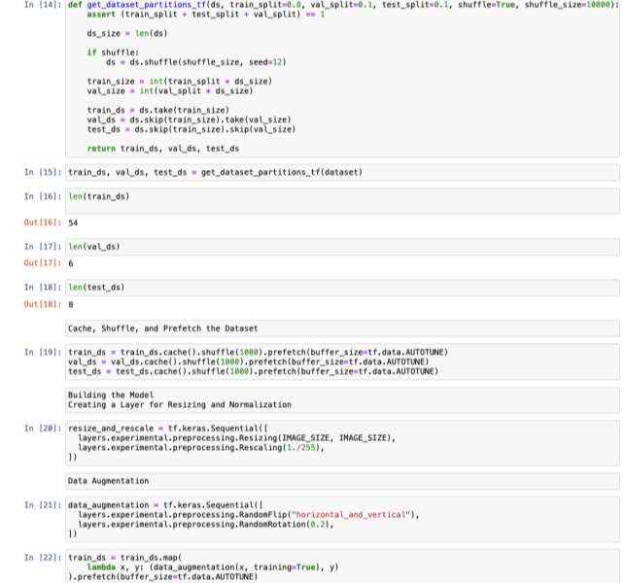
Data Augmentation

Slide 11


Building the Model
•
•

Slide 12
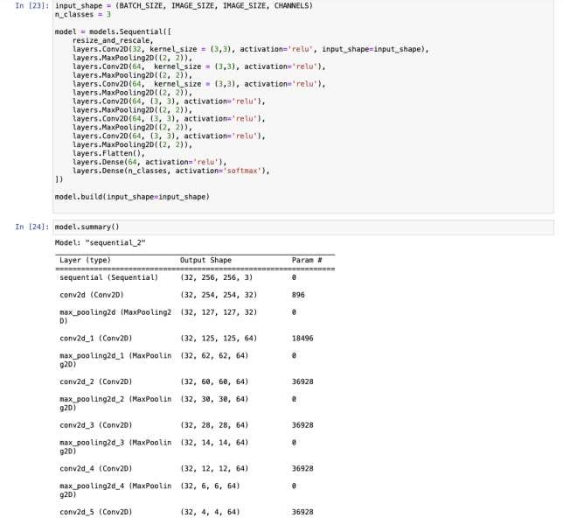
Model Architecture We are going to
use convolutional neural network (CNN)

Slide 13
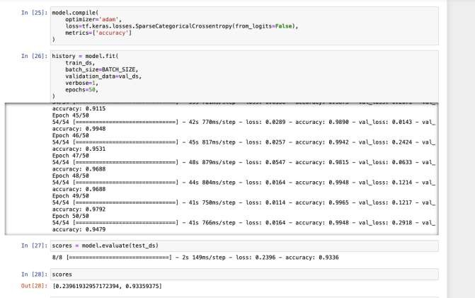
Compiling the Model

Slide 14
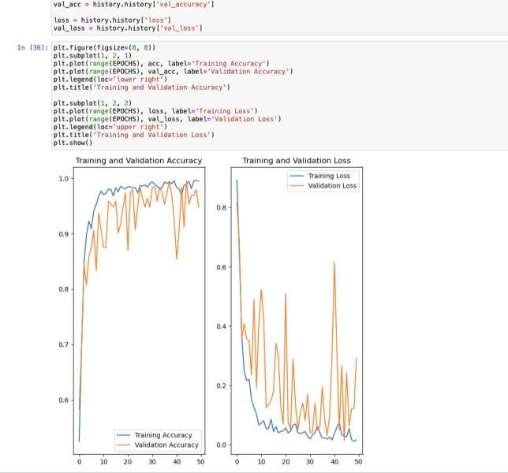
Plot training history on graphs

Slide 15
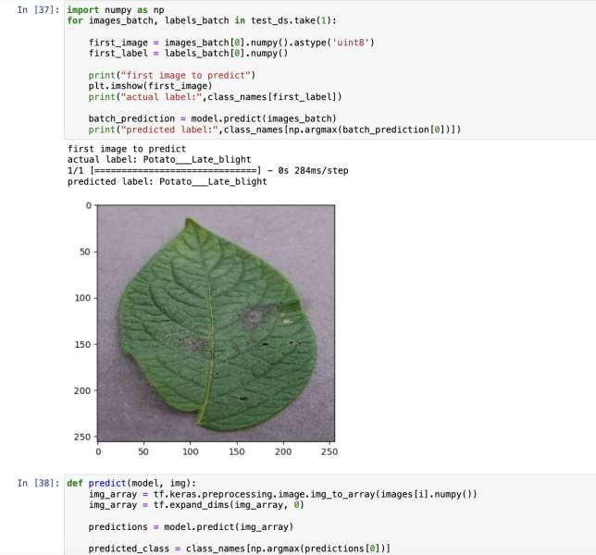
Running the prediction on a sample image

Slide 16

Conclusion
•

Slide 17
References
https://kaggle.com/datasets/rizwan123456789/potato-disease-leaf-datasetpld
https://www.kaggle.com/datasets/arjuntejaswi/plant-village
https://www.kaggle.com/datasets/sumanrathaur/potato-disease
4. https://www.kaggle.com/datasets/shuvokumarbasak4004/latest-and-
update-potato-leaf-diseases-dataset

Slide 18



Thank you

